Slide 1

CH 42010: PROCESS PLANT OPERATION & SAFETY
LTP: 3-0-0, CRD: 3
Lecture 4
Operations at Steady State

Slide 2
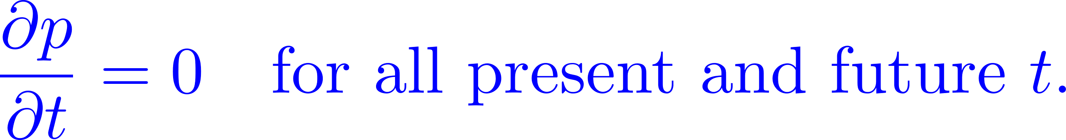
STEADY STATE
In systems theory, a system or a process is in a steady state if the variables (called state variables) which define the behavior of the system or the process are unchanging in time.
In continuous time, this means that for those properties/variables ‘p’ of the system, the partial derivative with respect to time is zero and remains so:
In discrete time, it means that the first difference of each property/variable is zero and remains so:
A steady state flow process requires conditions at all points in an apparatus remain constant as time changes. There must be no accumulation of mass or energy over the time period of interest.
The same mass flow rate will remain constant in the flow path through each element of the system. Thermodynamic properties may vary from point to point, but will remain unchanged at any given point.

Slide 3
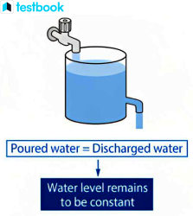
STEADY STATE
Steady state is a more general situation than dynamic equilibrium.
While a dynamic equilibrium occurs when two or more reversible processes occur at the same rate, and such a system can be said to be in steady state.
A system that is in steady state may not necessarily be in a state of dynamic equilibrium, because some of the processes are not reversible.
The principle of steady state flow in thermodynamics and fluid mechanics states that the properties of a fluid, such as density, pressure, and velocity, remain constant at any given point in a system over time, as long as there is no change in the overall energy or mass of the system.
This principle applies to both incompressible and compressible fluids but is more commonly used in the analysis of incompressible fluids.
Source: Google Images

Slide 4
STEADY STATE
Steady state refers to a condition in a process system where all operational parameters, such as temperature, pressure, flow rates, and concentrations, remain constant over time.
This happens when the input and output rates of material, energy, and momentum are balanced. Essentially, the system is in equilibrium, with no net accumulation or depletion within the process.
For example: In a continuous chemical reactor, steady state is achieved when the rates of reactant addition and product removal are constant, and the internal conditions of the reactor remain unchanged.

Slide 5
STEADY STATE
Importance of Steady State in Plant Operations:
Efficiency:
Achieving steady state ensures that the process operates at optimal conditions, maximizing productivity while minimizing waste.
Dynamic changes or unsteady conditions can lead to inefficiencies, such as energy loss or raw material wastage.
Product Quality:
Many processes, such as chemical reactions or material synthesis, require stable conditions to produce consistent, high-quality products.
Variations in operating parameters during unsteady conditions can result in defects, impurities, or off-specification products.
Energy Conservation:
At steady state, energy input matches the energy demands of the process, avoiding overuse or underutilization.
This reduces energy losses associated with frequent start-ups, shutdowns, or process fluctuations.

Slide 6
STEADY STATE
Challenges and Considerations in Achieving Steady State:
Start-up and shutdown procedures often involve transient conditions where steady state is not yet established.
External factors, such as changes in feed composition or environmental conditions, can disrupt steady state.
Maintaining steady state requires proper instrumentation and control systems to monitor and adjust operational parameters continuously.
Practical Examples:
Distillation Column:
At steady state, the column maintains constant temperature and composition profiles, ensuring the separation process is efficient and the desired purity levels are achieved.
Power Plant:
Operating at steady state allows the plant to produce electricity at a consistent output, minimizing fuel consumption and wear on equipment.

Slide 7
PROCESS MODELS FOR STEADY STATE OPERATIONS
Process models are mathematical representations of industrial systems that describe the relationships between inputs, outputs, and internal variables under specific conditions.
In steady-state operations, these models assume that all system parameters remain constant over time, which simplifies the analysis and design of processes.
Key Components of Steady-State Models:
Mass Balance: Ensures that the mass entering and leaving the system is balanced, with no accumulation.
Input − Output + Generation − Consumption = Accumulation
Energy Balance: Describes how energy is transferred, used, or lost within the system.
Input − Output + Generation − Consumption = Accumulation
Equilibrium Relationships: Governs reactions, phase separations, and transport phenomena under steady conditions.
Examples: Chemical reaction equilibrium or vapor-liquid equilibrium.

Slide 8
PROCESS MODELS FOR STEADY STATE OPERATIONS
How Steady-State Process Models Predict System Behavior?
Prediction of Process Outputs:
Process models allow engineers to calculate outputs, such as product composition, flow rates, and temperature, based on known inputs like feed conditions, pressure, and heat addition.
Simulation of Design Changes:
By altering inputs (e.g., feed rate or reactor temperature), the model can predict how the process will perform under new conditions.
Example: In a distillation column, increasing reflux ratio can predict changes in separation efficiency.
Optimization of Operating Conditions:
Models identify optimal operating points to maximize efficiency, yield, or energy conservation.
Example: A chemical reactor model can determine the ideal temperature and pressure for maximum conversion.
Sensitivity Analysis:
Process models assess how sensitive the system is to variations in inputs, aiding in robust process design.
Example: A heat exchanger model can predict how small changes in inlet temperature affect outlet conditions.

Slide 9
PROCESS MODELS FOR STEADY STATE OPERATIONS
Benefits of Steady-State Models in Industrial Operations
Improved Process Control: Helps maintain steady operations by identifying key control variables and set points.
Design Validation: Verifies the feasibility of proposed process designs before implementation.
Economic Analysis: Evaluates the cost-effectiveness of different operating scenarios.
Process Safety: Identifies conditions that might lead to unsafe operations, such as overheating or excessive pressure.
Applications of Steady-State Process Models
Chemical Reactors:
Steady-state models predict conversion rates, yields, and heat requirements.
For example, models of plug-flow or continuously stirred tank reactors (CSTR) are used to evaluate reaction performance.
Heat Exchangers:
Models calculate heat transfer rates and temperature profiles, optimizing energy usage in heating or cooling processes.
Distillation Columns:
Predicts the number of stages, reflux ratio, and feed conditions needed for desired separation.
Water Treatment Plants:
Models predict the removal efficiency of contaminants and chemical usage under steady conditions.

Slide 10
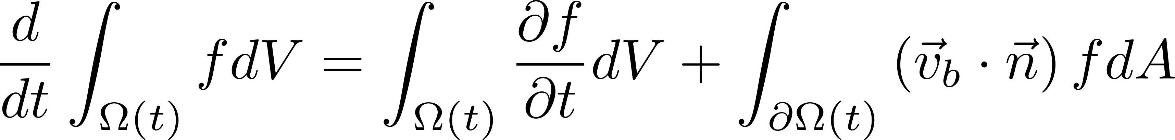
STEADY STATE OPERATIONS
Mass Balances
Input − Output + Generation − Consumption = Accumulation
For fluids, it is difficult to analyze a system (or volume) from fluid by considering or tracking the same particle.
A system [also called a closed system] is a quantity of matter of fixed identity. No mass can cross a system boundary.
For fluids we assumed a definite volume in space that forms the required environment and we can apply mechanics principles on the volume. Such volumes are called control volumes.
A control volume [also called an open system] is a region in space chosen for study. Mass can cross a control surface (the surface of the control volume).
The fundamental conservation laws (conservation of mass, energy, etc.) apply directly to systems.
The conversion from system analysis to control volume analysis is represented by Reynolds Transport Theorem (RTT).

Slide 11
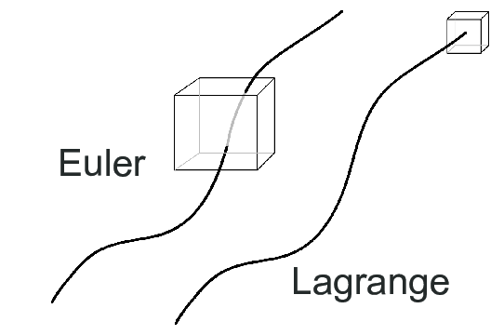
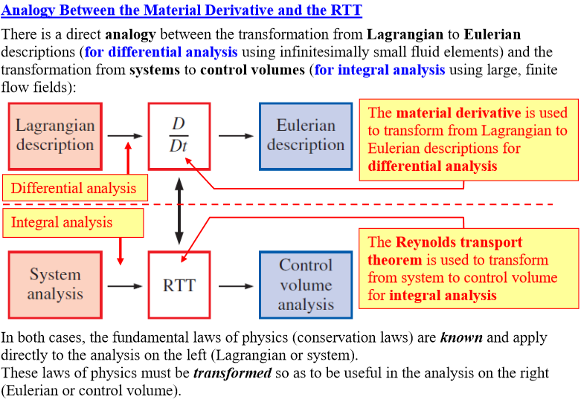
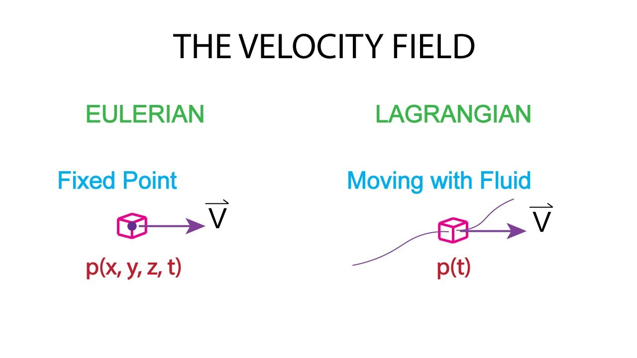
STEADY STATE OPERATIONS
Mass Balances
Analogy b/w Material derivative and the RTT
Source: Google Images

Slide 12
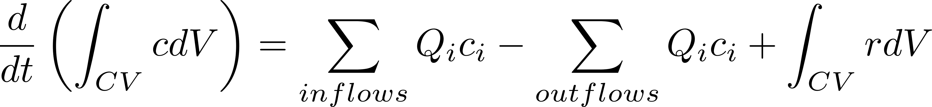
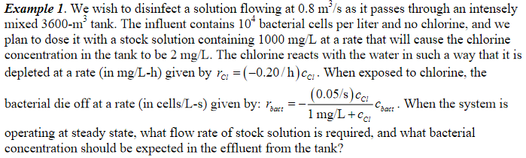
STEADY STATE OPERATIONS
Mass Balance in a Reactor
where r is the reaction rate expression and corresponds to the rate of generation of i in the CV, with units of mass/volume-time.

Slide 13
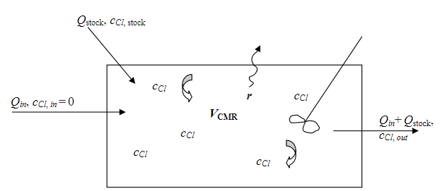
STEADY STATE OPERATIONS
Mass Balance in a Reactor
Applying the mass balance equation to Cl:
The system is operating at steady state, so the term on the left of the equation is zero.
The reactor is intensely mixed with steady flows. As a result, the Cl concentration is the same everywhere inside the tank (c_{Cl}), and that concentration is also the concentration in the effluent (since the effluent must come from somewhere inside)
The reaction rate will be the same throughout the tank, which allows us to take r_{Cl} be taken outside the integral on the far right.
Therefore, noting that there are two inflows (the main inflow stream and the stock solution containing Cl) and one outflow, and that the main inflow stream contains no chlorine.

Slide 14
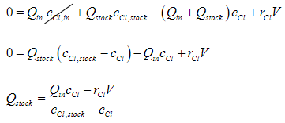
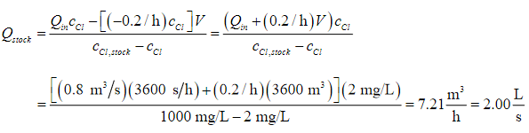
STEADY STATE OPERATIONS
Mass Balance in a Reactor

Slide 15
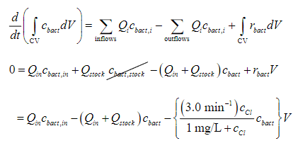
STEADY STATE OPERATIONS
Mass Balance in a Reactor

Slide 16
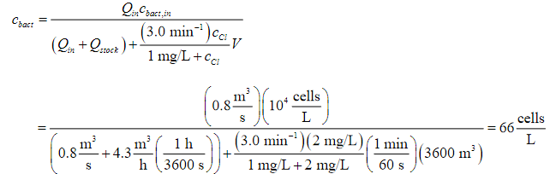
STEADY STATE OPERATIONS
Mass Balance in a Reactor
Thus, the bacterial concentration is reduced from 10,000 to 66 cells/L as the water passes through the tank.

Slide 17
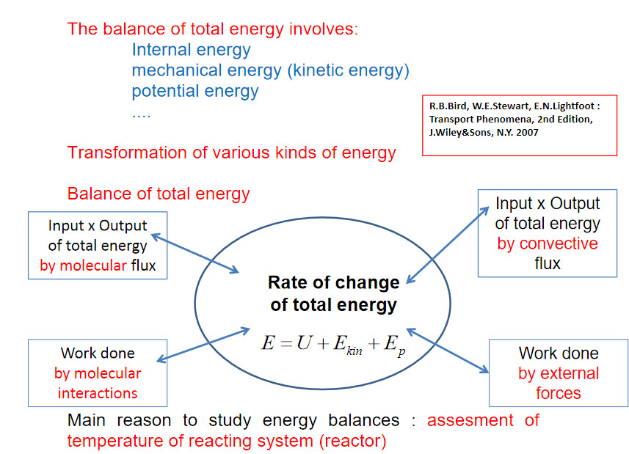
STEADY STATE OPERATIONS
Energy Balance in a Reactor
Most of reactions are not carried out isothermally.
For non-isothermal reactors (adiabatic and nonadiabatic) we need the energy balance together with the mass balances in order to arrive at reactor design equations.
However, even for isothermal reactors we need the energy balance to determine what heat duty is necessary in order to keep the reactor isothermal.
The energy balance is the principle of conservation of energy or the first law of thermodynamics as applied to our reaction system

Slide 18
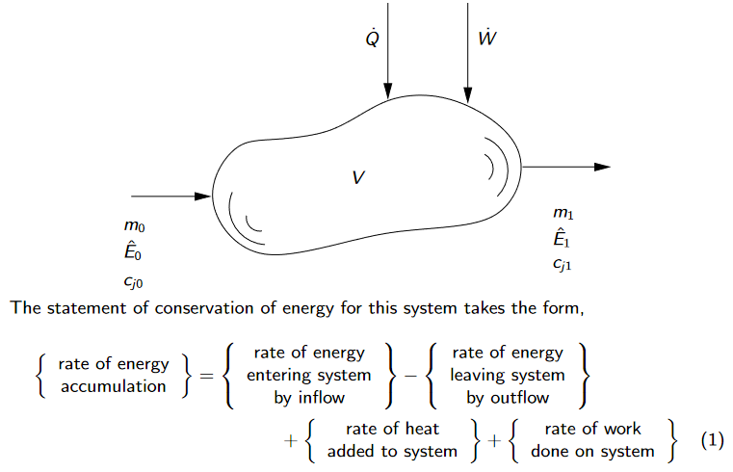
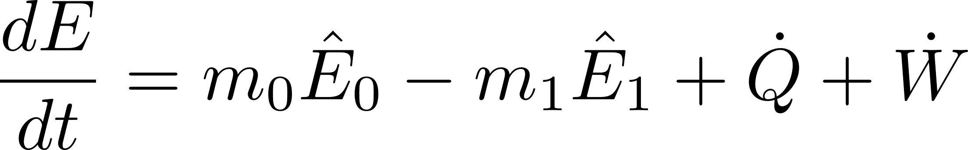

STEADY STATE OPERATIONS
Energy Balance in a Reactor
We derive the energy balance by considering an arbitrary reactor volume element:
in which the hat indicates an energy per unit mass.

Slide 19
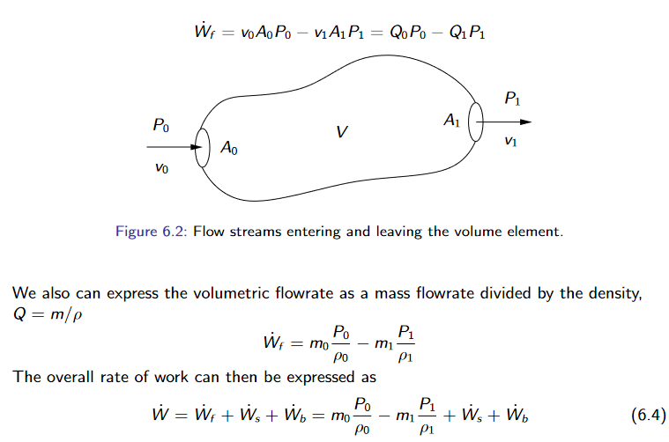
STEADY STATE OPERATIONS
Energy Balance in a Reactor
Work done by the flow streams:

Slide 20
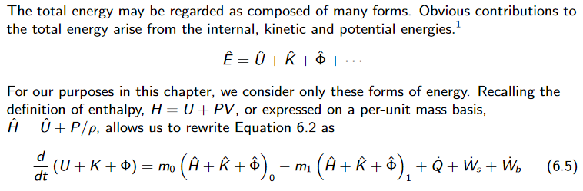
STEADY STATE OPERATIONS
Energy Balance in a Reactor

Slide 21
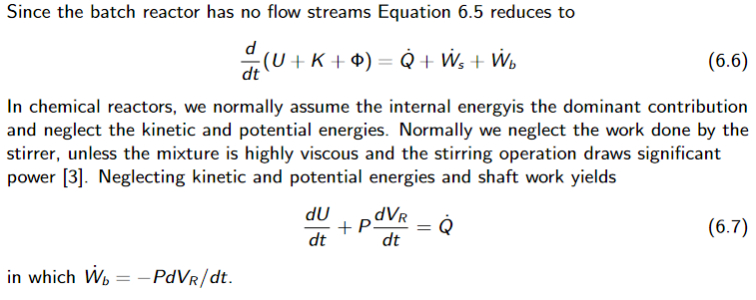
STEADY STATE OPERATIONS
Energy Balance in a BATCH Reactor

Slide 22
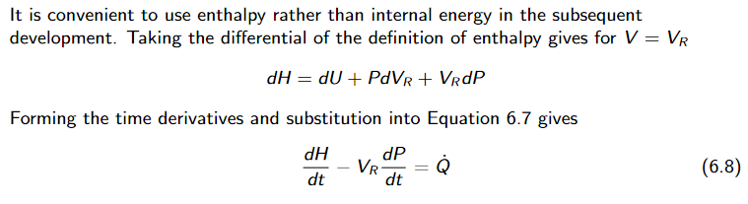
STEADY STATE OPERATIONS
Energy Balance in a BATCH Reactor

Slide 23
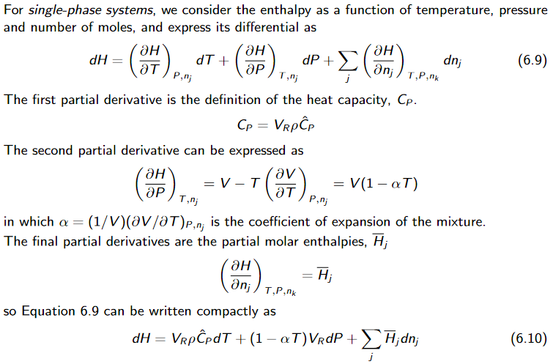
STEADY STATE OPERATIONS
Energy Balance in a BATCH Reactor

Slide 24
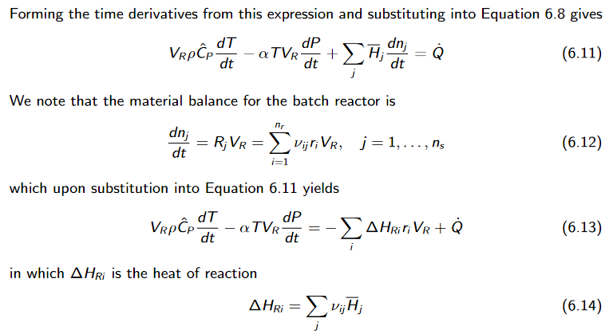
STEADY STATE OPERATIONS
Energy Balance in a BATCH Reactor

Slide 25
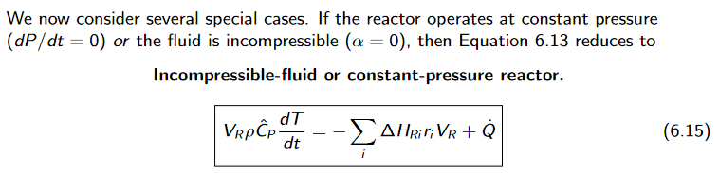
STEADY STATE OPERATIONS
Energy Balance in a BATCH Reactor
A plethora of special cases — incompressible

Slide 26
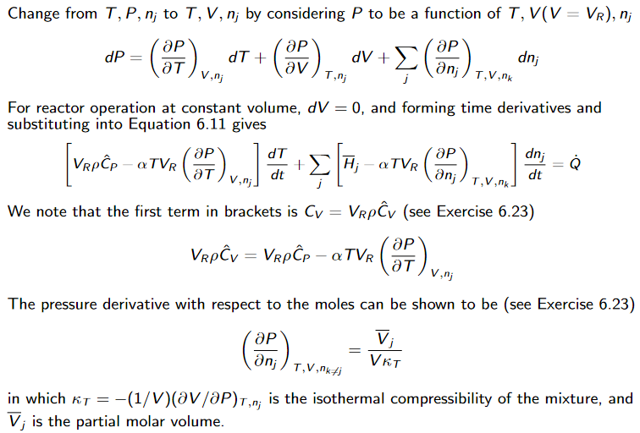
STEADY STATE OPERATIONS
Energy Balance in a BATCH Reactor
A plethora of special cases — constant volume

Slide 27
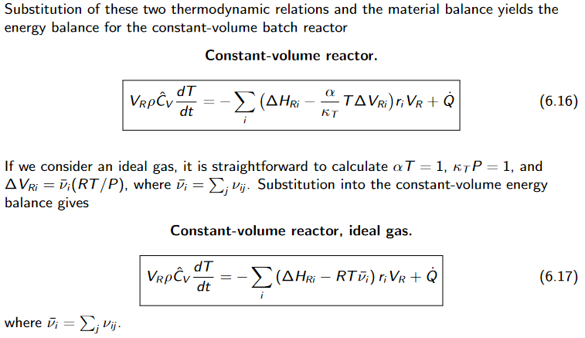
STEADY STATE OPERATIONS
Energy Balance in a BATCH Reactor
A plethora of special cases — constant volume

Slide 28
STEADY STATE OPERATIONS
Energy Management – Why?
Energy Efficiency:
Steady-state operations provide a consistent framework for evaluating and optimizing energy inputs relative to outputs.
Efficient energy use reduces operating costs and enhances overall profitability.
Environmental Impact:
Reducing energy waste minimizes greenhouse gas emissions and supports environmental sustainability.
Efficient operations ensure compliance with environmental regulations.
Process Stability:
Maintaining steady energy flow ensures the reliability of critical process parameters, such as temperature, pressure, and reaction rates.
Stability minimizes wear and tear on equipment, reducing maintenance costs.
Product Quality:
Consistent energy management ensures that the required conditions for production are met, maintaining high-quality output.

Slide 29
STEADY STATE OPERATIONS
Energy Management - Strategies for Energy Management at Steady State
Energy Audits and Monitoring:
Conduct regular audits to identify inefficiencies in energy usage.
Use advanced sensors and meters to monitor energy consumption in real time.
Example: Monitoring heat losses in heat exchangers or steam systems can highlight areas for insulation improvement.
Optimization of Process Conditions:
Operate equipment at optimal load conditions to maximize efficiency.
Fine-tune parameters such as temperature, flow rate, and pressure to minimize energy input for the desired output.
Example: Adjusting boiler pressure to meet steam demand without excess production reduces fuel consumption.
Waste Heat Recovery:
Implement heat recovery systems to capture and reuse energy from hot exhaust gases, cooling water, or process streams.
Use recovered heat for preheating feedstocks, generating steam, or space heating.
Example: A regenerator in a distillation process recycles heat from outgoing streams to preheat incoming feeds.

Slide 30
STEADY STATE OPERATIONS
Energy Management - Strategies for Energy Management at Steady State
Upgrade Equipment and Technology:
Replace outdated machinery with energy-efficient models, such as variable-speed pumps or high-efficiency motors.
Use advanced control systems, like distributed control systems (DCS) or artificial intelligence, to optimize operations.
Use Renewable Energy Sources:
Incorporate solar, wind, or biomass energy where feasible to reduce dependence on fossil fuels.
Example: Solar-powered water heating for pre-process operations.
Minimize Idle Time:
Avoid operating equipment at low loads or when not in use.
Schedule processes to align with peak efficiency hours to reduce energy losses.
Insulation and Maintenance:
Properly insulate equipment like pipes, tanks, and boilers to prevent energy loss.
Regular maintenance ensures equipment operates at peak efficiency, minimizing energy wastage.
Energy Storage Systems:
Use batteries or other storage technologies to manage excess energy generated during low-demand periods.

Slide 31
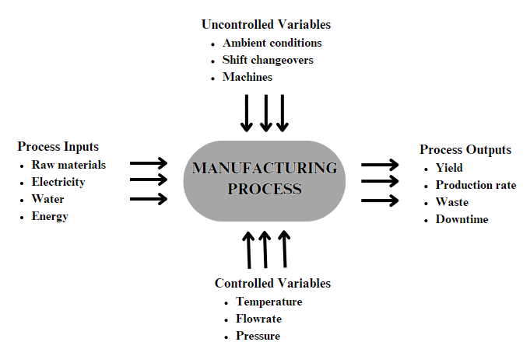
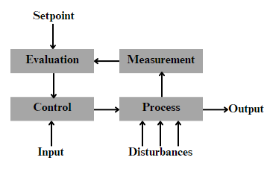
STEADY STATE OPERATIONS
Process Control for Maintaining Steady State
Process control refers to the monitoring and adjusting process parameters to get a preset or desirable output.
Deployment of automated process control systems delivers the following benefits:
Energy Efficiency
Increase Automation & Throughput
Quality Assurance
Improved Safety
Source: Google Images

Slide 32
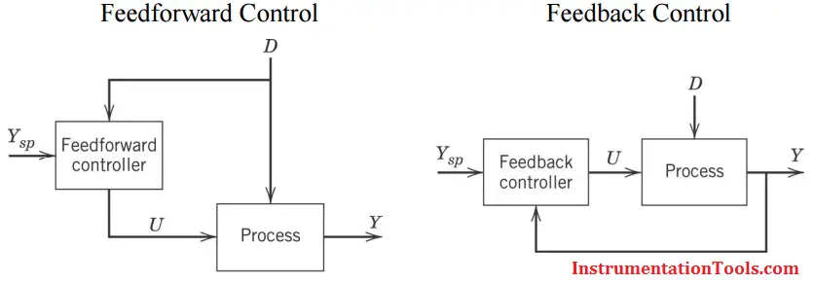
STEADY STATE OPERATIONS
Process Control for Maintaining Steady State
Source: Google Images

Slide 33
STEADY STATE OPERATIONS
Process Control for Maintaining Steady State
ADVANTAGES
DISADVANTAGES
Corrective action occurs as soon as the controlled variable deviates from the set point, regardless of the source and type of disturbance.
Feedback control requires minimal knowledge about the process to be controlled; it particular, a mathematical model of the process is not required, although it can be very useful for control system design.
The ubiquitous PID controller is both versatile and robust. If process conditions change, retuning the controller usually produces satisfactory control.
No corrective action is taken until after a deviation in the controlled variable occurs. Thus, perfect control, where the controlled variable does not deviate from the set point during disturbance or set-point changes, is theoretically impossible.
Feedback control does not provide predictive control action to compensate for the effects of known or measurable disturbances.
It may not be satisfactory for processes with large time constants and/or long time delays. If large and frequent disturbances occur, the process may operate continuously in a transient state and never attain the desired steady state.
In some situations, the controlled variable cannot be measured on-line, and, consequently, feedback control is not feasible.
FEEDBACK CONTROL

Slide 34
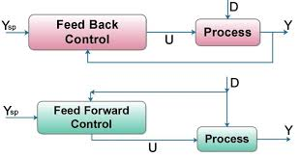
STEADY STATE OPERATIONS
Process Control for Maintaining Steady State
FEEDFORWARD CONTROL
The basic concept of feedforward control is to measure important disturbance variables and take corrective action before they upset the process.
DISADVANTAGES
The disturbance variables must be measured on-line. In many applications, this is not feasible.
To make effective use of feedforward control, at least an approximate process model should be available. In particular, we need to know how the controlled variable responds to changes in both the disturbance and manipulated variables. The quality of feedforward control depends on the accuracy of the process model.
Ideal feedforward controllers that are theoretically capable of achieving perfect control may not be physically realizable. Fortunately, practical approximations of these ideal controllers often provide very effective control.
Source: Google Images

Slide 35
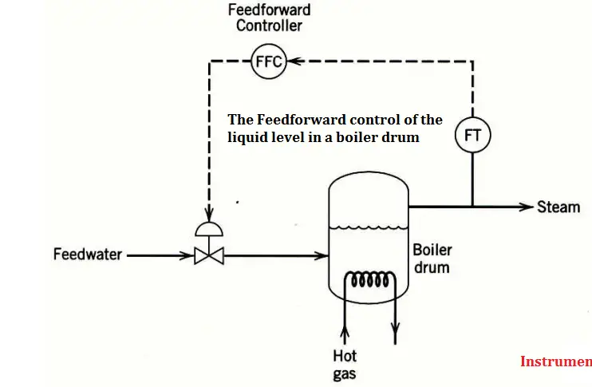
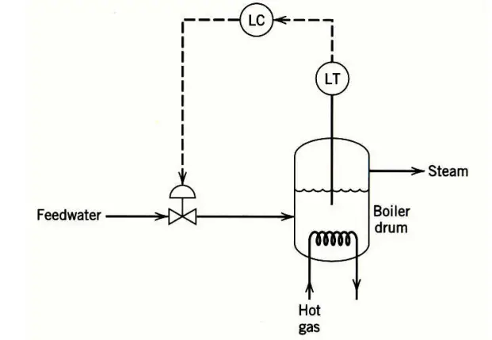
STEADY STATE OPERATIONS
Process Control for Maintaining Steady State
A boiler drum with a conventional feedback control system is shown in Fig.1 The level of the boiling liquid is measured and used to adjust the feedwater flow rate.
This control system tends to be quite sensitive to rapid changes in the disturbance variable, steam flow rate, as a result of the small liquid capacity of the boiler drum. Rapid disturbance changes can occur as a result of steam demands made by downstream processing units.
The feedforward control scheme in below Fig can provide better control of the liquid level. Here the steam flow rate is measured, and the feedforward controller adjusts the feedwater flow rate.
Source: Google Images

Slide 36
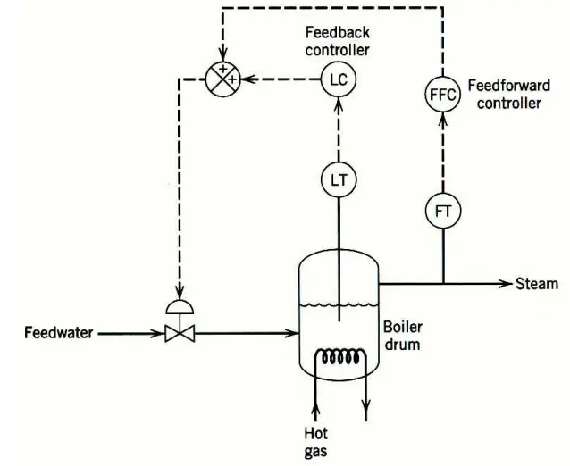
STEADY STATE OPERATIONS
Process Control for Maintaining Steady State
In practical applications, feedforward control is normally used in combination with feedback control.
Feedforward control is used to reduce the effects of measurable disturbances, while feedback trim compensates for inaccuracies in the process model, measurement error, and unmeasured disturbances.
Source: Google Images

Slide 37
STEADY STATE OPERATIONS
Process Control for Maintaining Steady State
Controller | Estimates | When to use | Examples
P | Present | Systems with slow response, systems tolerant to offset | Float valves, thermostats, Humidistat
I | Back | Not often used alone, as is too slow | Used for very noisy systems
D | Forward | Not used alone because it is too sensitive to noise and does not have set point | None
PI | Present & Back | Often used | Thermostats, Flow control, Pressure control
PID | All Time | Often used, most robust, but can be noise sensitive | Cases where system has inertia that could get out of hand; i.e. temperature and concentration measurements on a reactor to avoid runaway

Slide 38
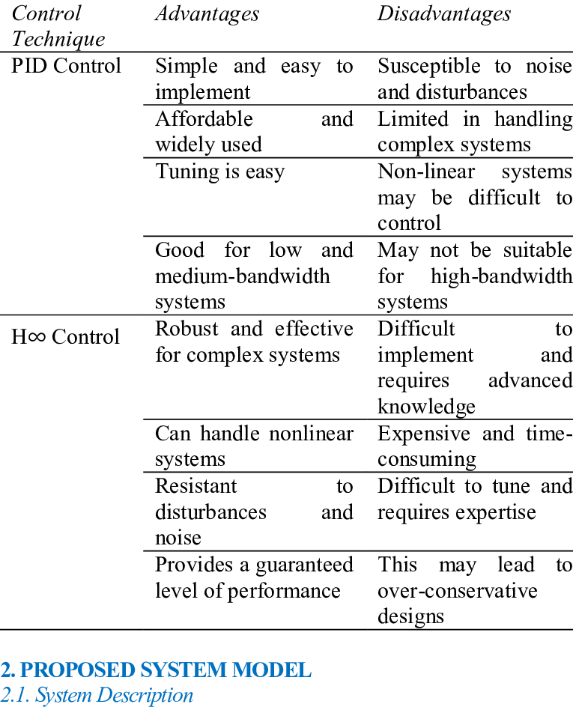
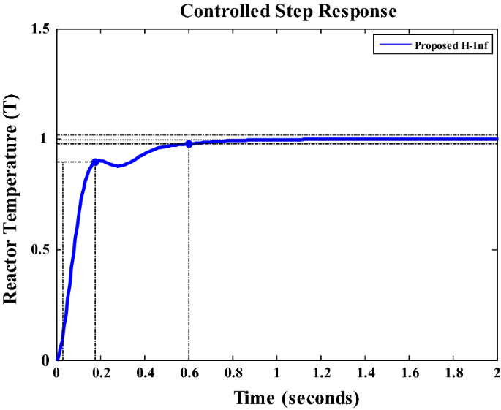
STEADY STATE OPERATIONS
Process Control for Maintaining Steady State
Source: Google Images

Slide 39
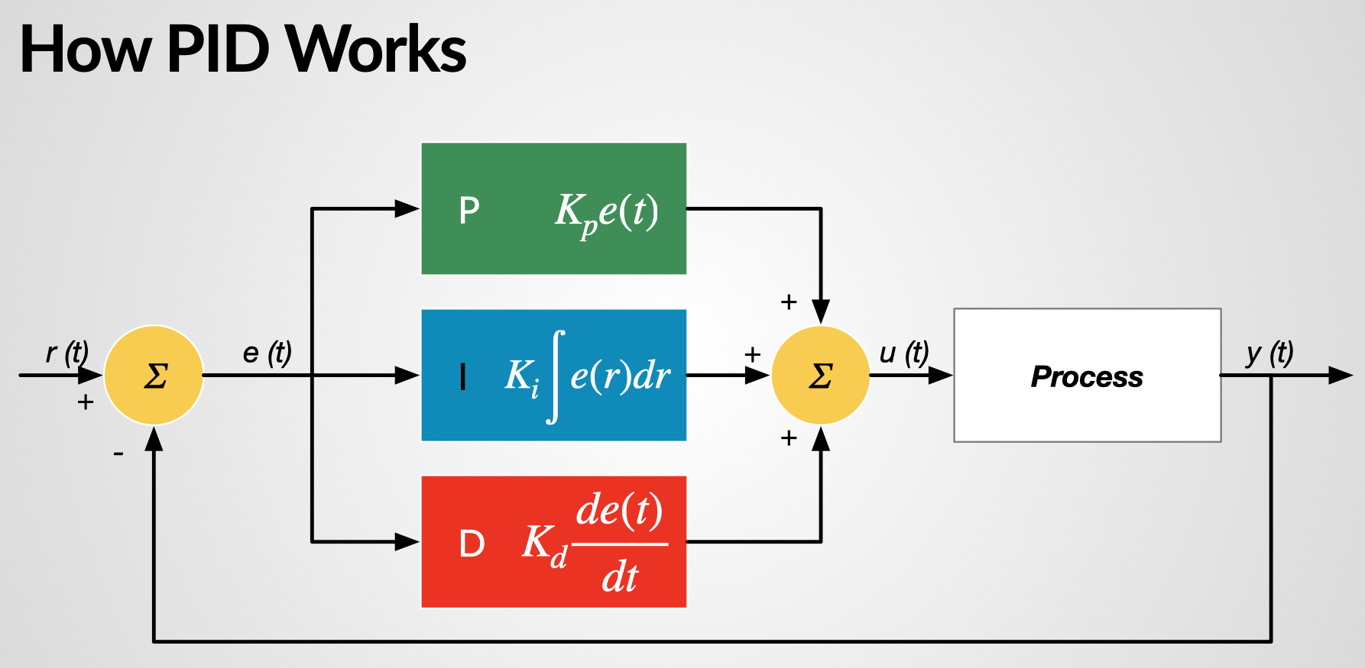
STEADY STATE OPERATIONS
Process Control for Maintaining Steady State
Source: Google Images

Slide 40
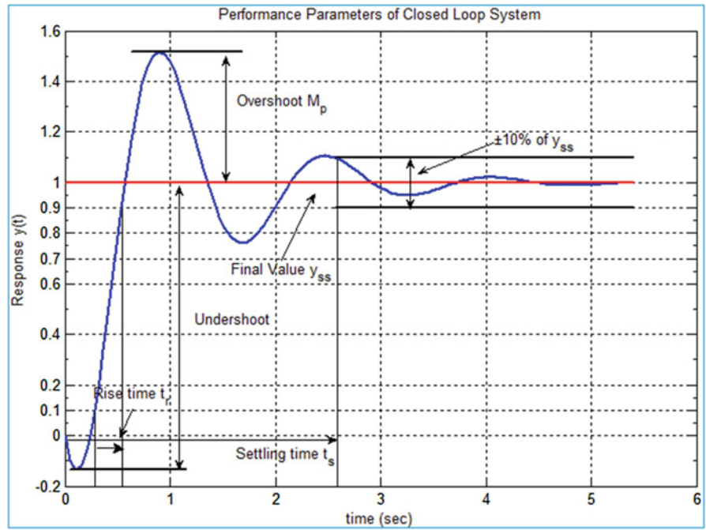
STEADY STATE OPERATIONS
Process Control for Maintaining Steady State
Source: Google Images

Slide 41
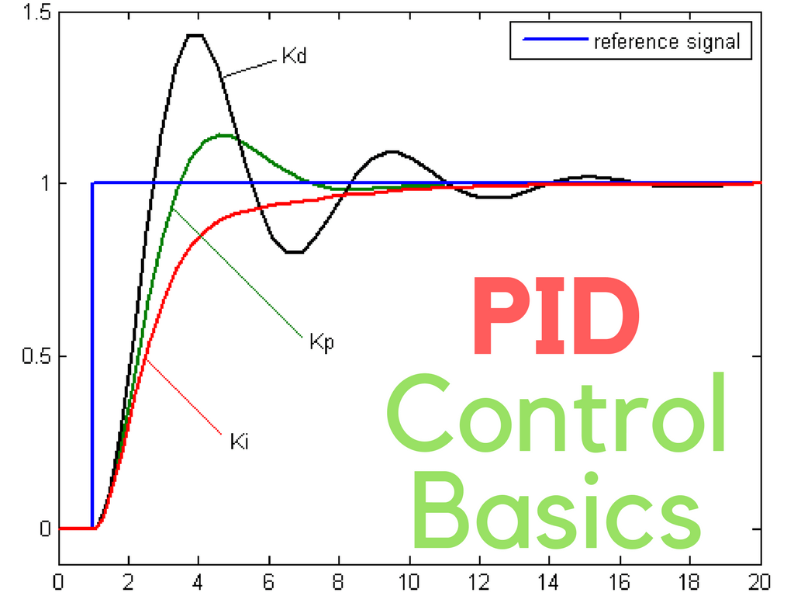
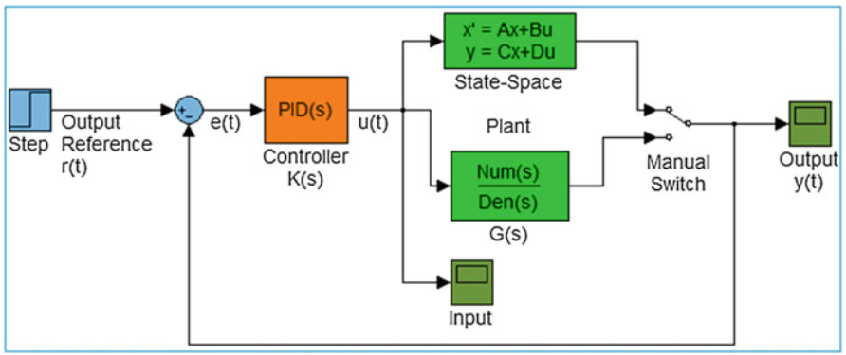
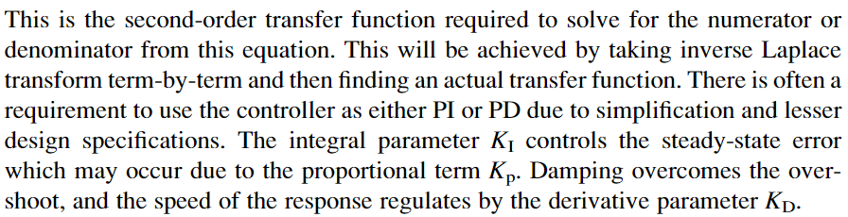

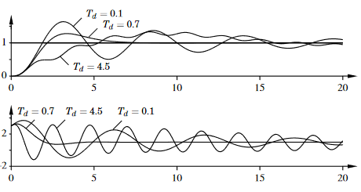
STEADY STATE OPERATIONS
Process Control for Maintaining Steady State
Source: Google Images
Book: Real Time Modeling, Simulation and Control of Dynamical Systems, Asif Mahmood Mughal, Springer

